Slide 1
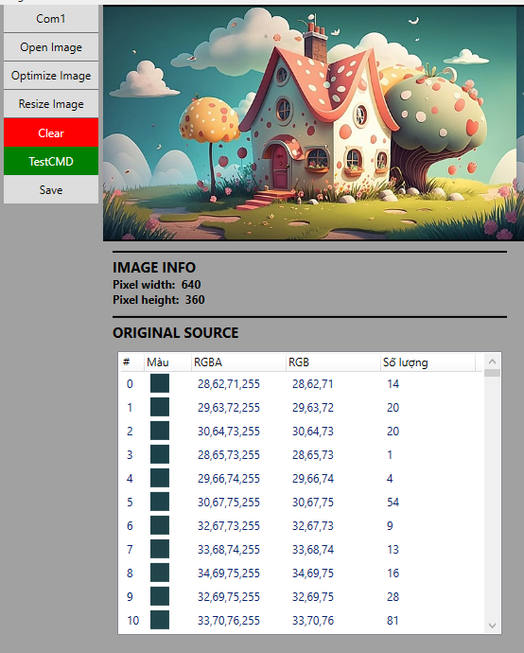


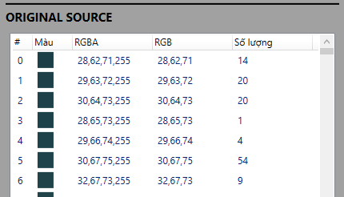
Khi có sự kiện chuột hover
Export to single frame of Spr file
Import to next frame of Spr work space

Slide 2
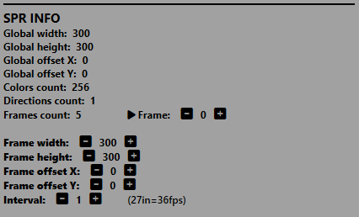
640
360
Export to single frame of Spr file
Import to next frame of Spr work space
640
360

